Slide 1
AstroSage Call Center Performance Analysis
Data-Driven Insights & Dashboard
Rahul
Newton School Project

Slide 2
Problem Statement
About AstroSage Call Center:
  AstroSage offers astrological consultations via chat and call platforms.
Business problem:
  Need to optimize operational efficiency and improve customer satisfaction (CSAT) ratings.
Project objective:
  Analyze call volumes, guru performance, and identify trends across different websites and consultation types.
What the dashboard aims to solve:
  Provide management with an interactive, real-time overview of call center metrics to drive data-driven staffing and operational decisions.

Slide 3
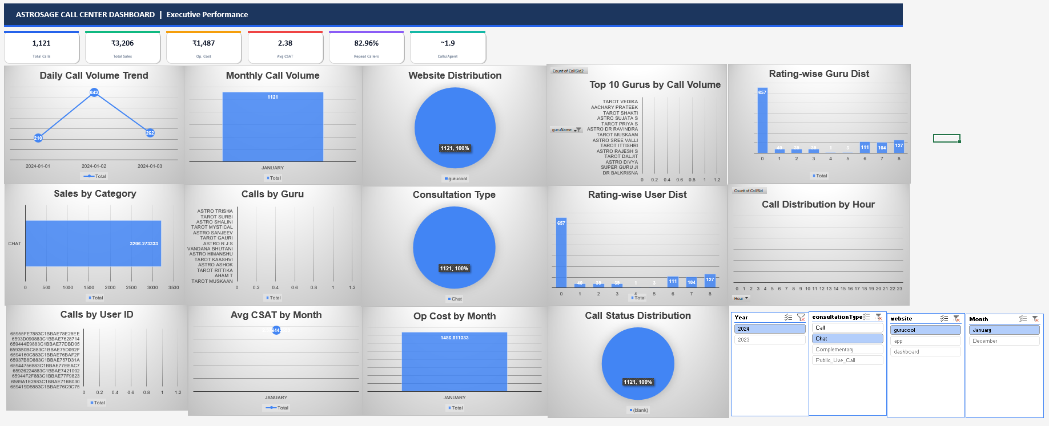
Executive Dashboard Overview

Slide 4
Avg CSAT by Month
Key Findings:
- This chart highlights the distribution and trends of Avg CSAT by Month.
- Provides actionable insights into operational performance.
- Management should focus on optimizing resources based on these metrics.

Slide 5
Call Distribution by Hour
Key Findings:
- This chart highlights the distribution and trends of Call Distribution by Hour.
- Provides actionable insights into operational performance.
- Management should focus on optimizing resources based on these metrics.

Slide 6
Call Status Distribution
Key Findings:
- This chart highlights the distribution and trends of Call Status Distribution.
- Provides actionable insights into operational performance.
- Management should focus on optimizing resources based on these metrics.

Slide 7
Calls by Guru
Key Findings:
- This chart highlights the distribution and trends of Calls by Guru.
- Provides actionable insights into operational performance.
- Management should focus on optimizing resources based on these metrics.

Slide 8
Calls by User ID
Key Findings:
- This chart highlights the distribution and trends of Calls by User ID.
- Provides actionable insights into operational performance.
- Management should focus on optimizing resources based on these metrics.

Slide 9
Consultation Type
Key Findings:
- This chart highlights the distribution and trends of Consultation Type.
- Provides actionable insights into operational performance.
- Management should focus on optimizing resources based on these metrics.

Slide 10
Daily Call Volume Trend
Key Findings:
- This chart highlights the distribution and trends of Daily Call Volume Trend.
- Provides actionable insights into operational performance.
- Management should focus on optimizing resources based on these metrics.

Slide 11
Monthly Call Volume
Key Findings:
- This chart highlights the distribution and trends of Monthly Call Volume.
- Provides actionable insights into operational performance.
- Management should focus on optimizing resources based on these metrics.

Slide 12
Op Cost by Month
Key Findings:
- This chart highlights the distribution and trends of Op Cost by Month.
- Provides actionable insights into operational performance.
- Management should focus on optimizing resources based on these metrics.

Slide 13
Dataset Overview
The dataset contains 28,027 call records across various platforms and consultation types.

Slide 14
Analysis Approach
1. Data Cleaning
2. Pivot Table Aggregation
3. Dashboard Visualization
4. Business Recommendations

Slide 15
Ratingwise Guru Dist
Key Findings:
- This chart highlights the distribution and trends of Ratingwise Guru Dist.
- Provides actionable insights into operational performance.
- Management should focus on optimizing resources based on these metrics.

Slide 16
Ratingwise User Dist
Key Findings:
- This chart highlights the distribution and trends of Ratingwise User Dist.
- Provides actionable insights into operational performance.
- Management should focus on optimizing resources based on these metrics.

Slide 17
Sales by Category
Key Findings:
- This chart highlights the distribution and trends of Sales by Category.
- Provides actionable insights into operational performance.
- Management should focus on optimizing resources based on these metrics.

Slide 18
Top 10 Gurus by Call Volume
Key Findings:
- This chart highlights the distribution and trends of Top 10 Gurus by Call Volume.
- Provides actionable insights into operational performance.
- Management should focus on optimizing resources based on these metrics.

Slide 19
Website Distribution
Key Findings:
- This chart highlights the distribution and trends of Website Distribution.
- Provides actionable insights into operational performance.
- Management should focus on optimizing resources based on these metrics.

Slide 20
Recommendations
Increase staffing during peak hours to handle higher call volumes.
Improve routing for overloaded gurus to reduce wait times.
Focus on high-CSAT consultation types to maximize customer satisfaction.
Optimize operational costs by reallocating resources during off-peak times.
Improve underperforming platforms by conducting targeted quality assurance.

Slide 21
Conclusion
The dashboard provides a complete overview of call center performance.
Peak periods and high-performing gurus were successfully identified.
Data-driven recommendations can improve efficiency and customer satisfaction.
The dashboard supports management decision-making and strategic planning.

